Slide 1

NEWS GROUP WEB APP
DBMS Project No 13
Instructor: Dr. Ranjana Vyas TA: Mr. Amit Prafulla
Submitted By :-
Group No F
Harpahul Singh Bhatia IIT2015082
Nikunj Sharma LIT2015003
Piyush Arora IIT2015071
Raghav Khandelwal lit2015002

Slide 2
Salient Features
Sign in to mark favorite news
Get latest news from all over the world on just a click
Select category and get news from only that category
Like and Comment on the news
Refresh to get Latest News

Slide 3
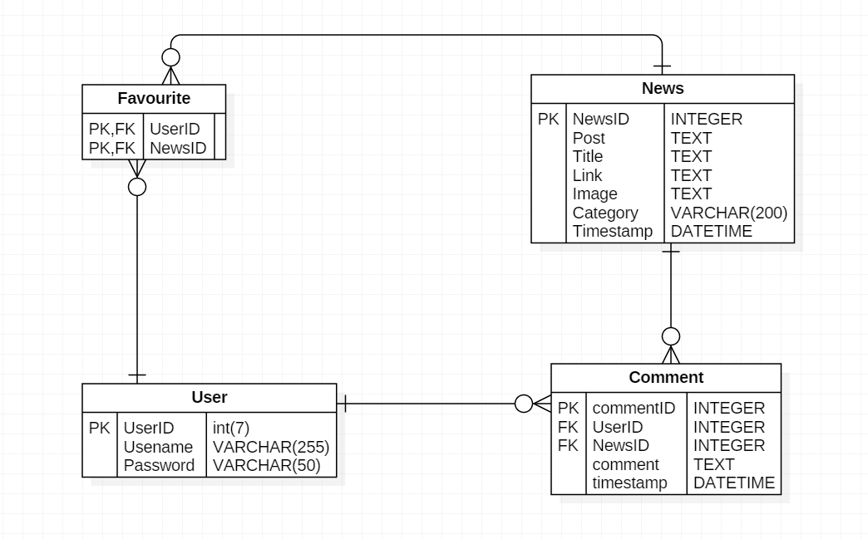
ER Diagram

Slide 4
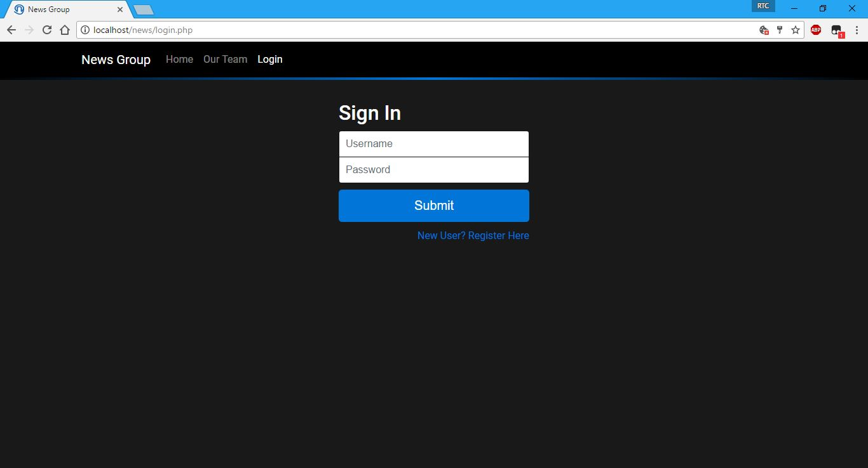
Login

Slide 5
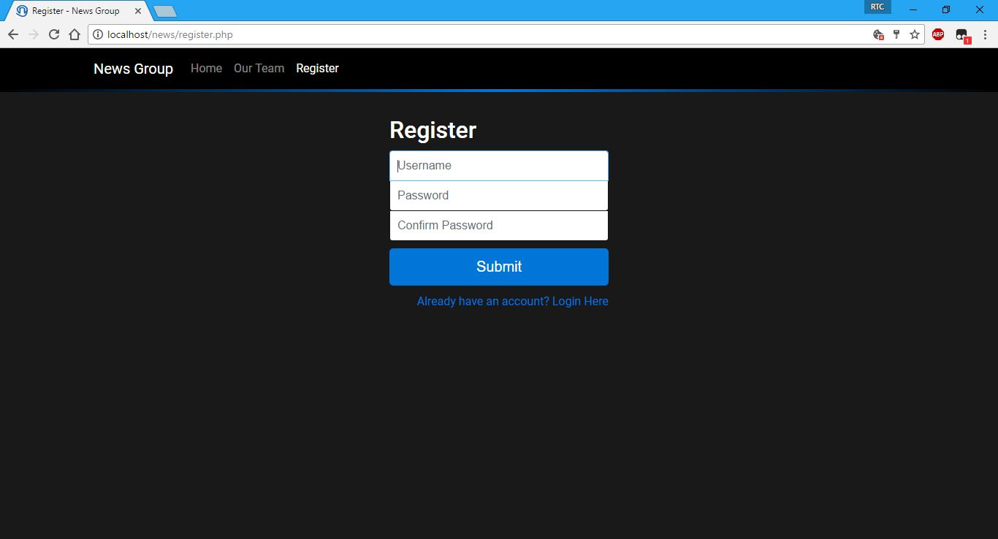
Register

Slide 6
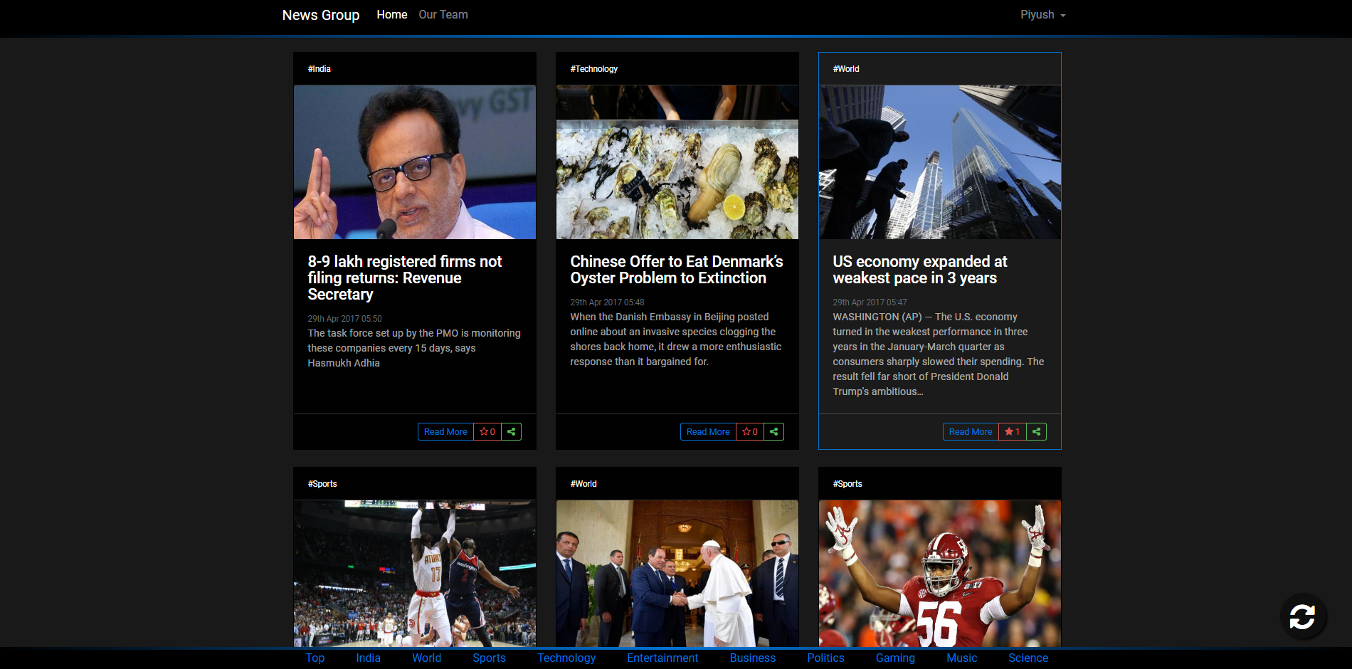
News group

Slide 7
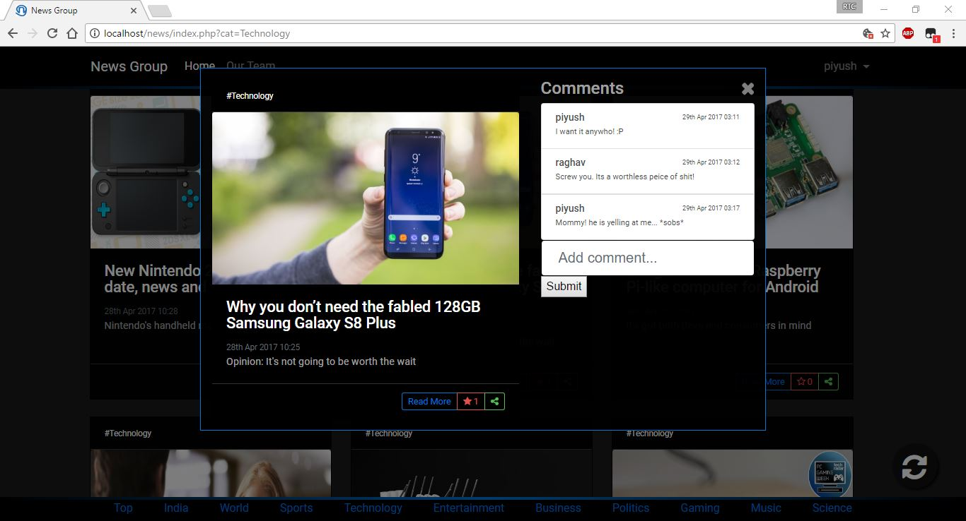
Comments

Slide 8















Sources
The Hindu
Hacker News
The Economist
Associated-Press
Techradar
IGN
BBC News
Buzzfeed
Polygon
ESPN
Entertainment Weekly
National Geographic
ESPN-Cric-Info
CNBC
MTV News

Slide 9
Thank you

